Slide 1


Huazhong University of Science and Technology
The Department of Electronics and Information Engineering
Electronic Circuit Analysis and Design
Dr. Tianping Deng
Email: dengtp@hust.edu.cn

Slide 2
Contents
PART 1 SEMICONDUCTOR DEVICES AND BASIC APPLICATIONS
Chapter 1 Semiconductor Materials and Diodes
Chapter 2 Diode Circuits
Chapter 3 The Field-Effect Transistor
Chapter 4 Basic FET Amplifiers
Chapter 5 The Bipolar Junction Transistor
Chapter 6 Basic BJT Amplifiers
Chapter 7 Frequency Response
Chapter 8 Output Stages and Power Amplifiers
PART 2 ANALOG ELECTRONICS
Chapter 9 Ideal Operational Amplifiers and Op-Amp Circuits
Chapter 10 Integrated Circuit Biasing and Active Loads
Chapter 11 Differential and Multistage Amplifiers
Chapter 12 Feedback and Stability
Chapter 13 Operational Amplifier Circuits
Chapter 14 Nonideal Effects in Operational Amplifier Circuits
Chapter 15 Applications and Design of Integrated Circuits
Chapter 10 Integrated Circuit Biasing and Active Loads

Slide 3

10.1 Bipolar Transistor Current Source
10.2 FET Current Source
10.3 Circuit with Active Loads
10.4 Small-Signal Analysis: Active Load Circuits

Slide 4
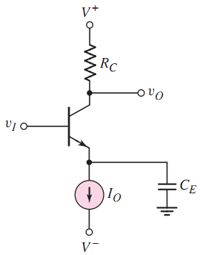
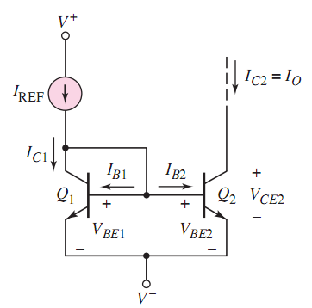
CE
Which Region？
Forward active region

Slide 5
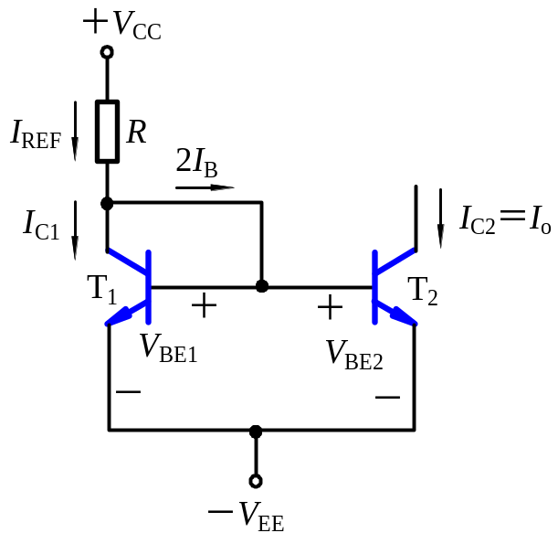



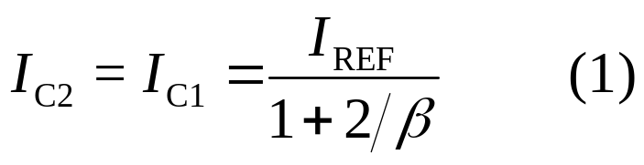



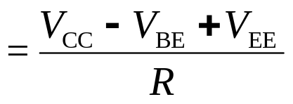
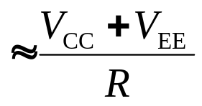
10.1 Bipolar Transistor Current Sources
10.1.1 Basic Current Source (Current Mirror)
T₁ ,T₂ are identical transistors.
I_{C2} is the mirror image of I_{C1}.
I_{C2} is almost constant, no matter the value of R_{C}.

Slide 6
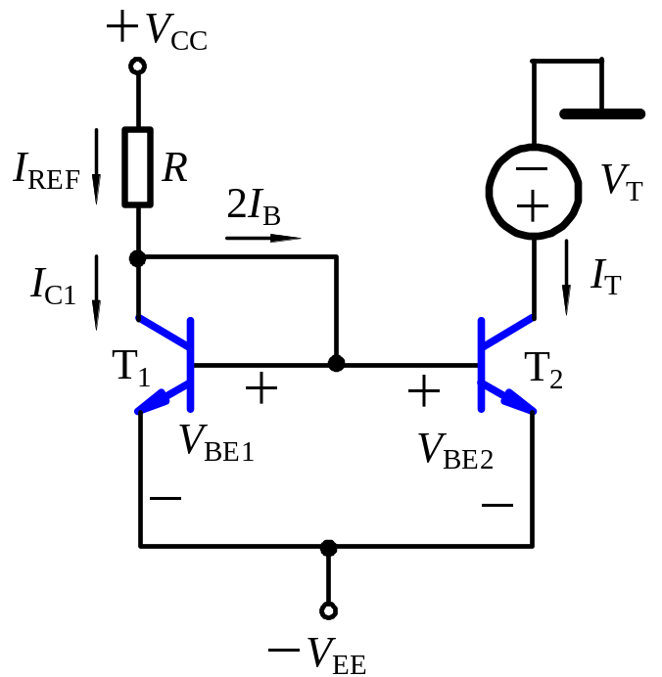


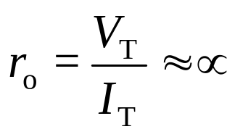
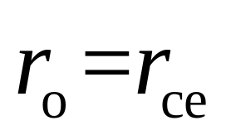
10.1.1 Basic Current Source (Current Mirror)
Because I_{C2} is almost constant, ac value of I_{C2} is
Output Resistance
In general, r_{o} is in order of 100 kΩ.

Slide 7
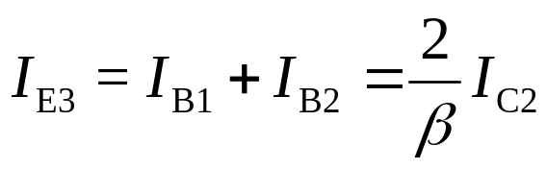
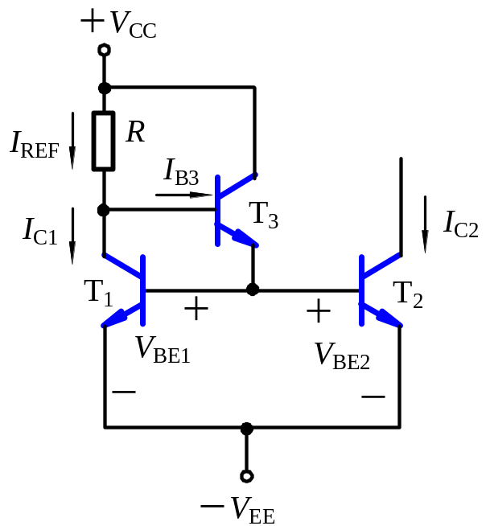
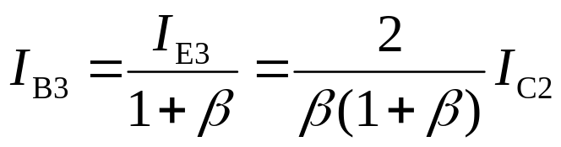
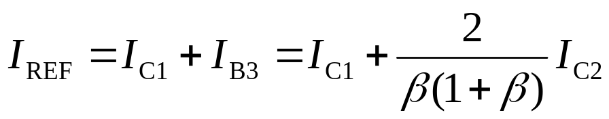
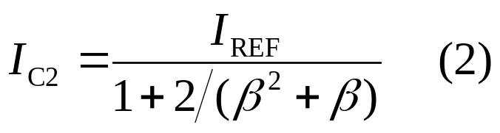
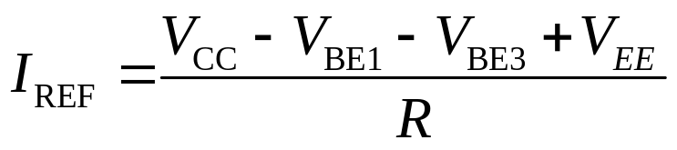
10.1.2 Improved Current Source
Comparing Expressions (1) and (2), when I_{C2}≈I_{REF}, the error of (2) can be reduced by adding transistor T₃.

Slide 8
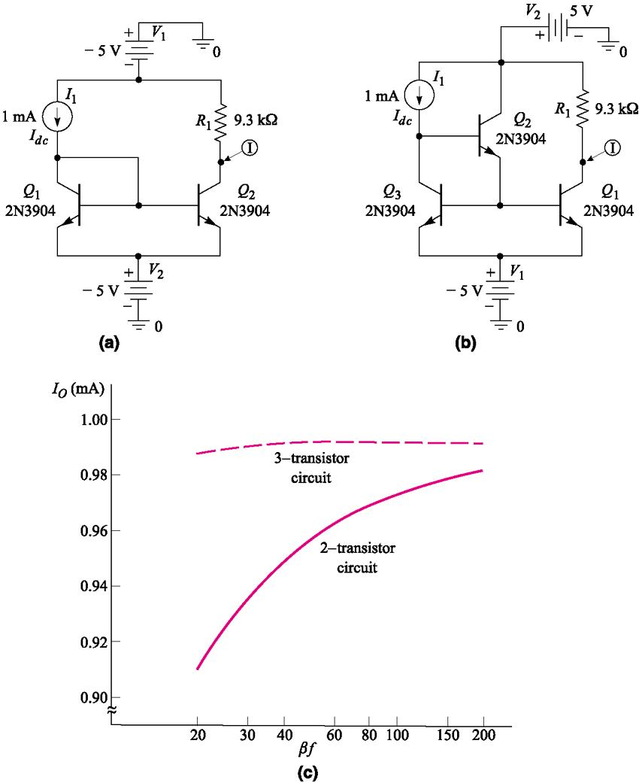
10.1.2 Improved Current Source

Slide 9
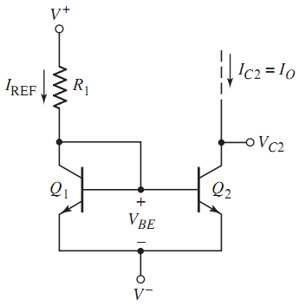




10.1.3 Widlar Current Source

Slide 10
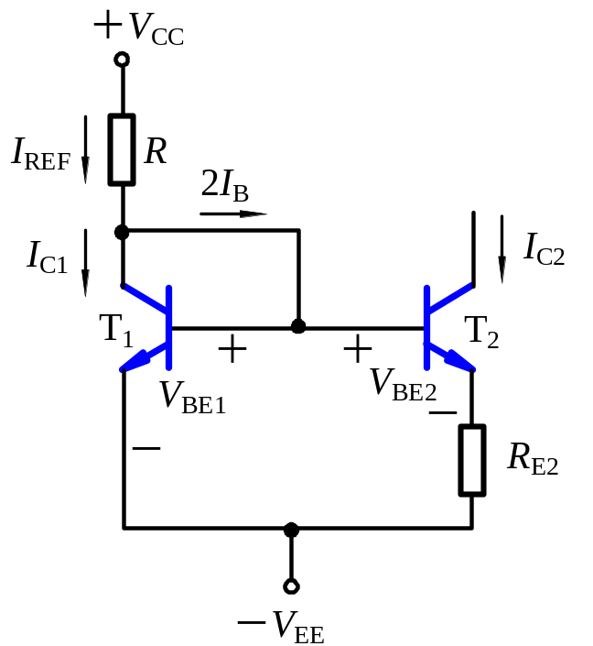
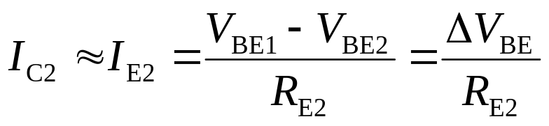
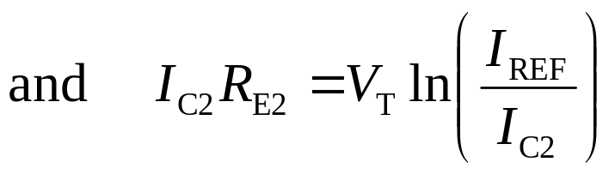
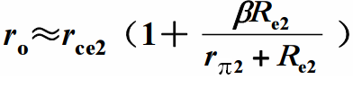
10.1.3 Widlar Current Source
Because ΔV_{BE} is very small, I_{C2} is very small.
(The process of derivation on page 81 ).

Slide 11
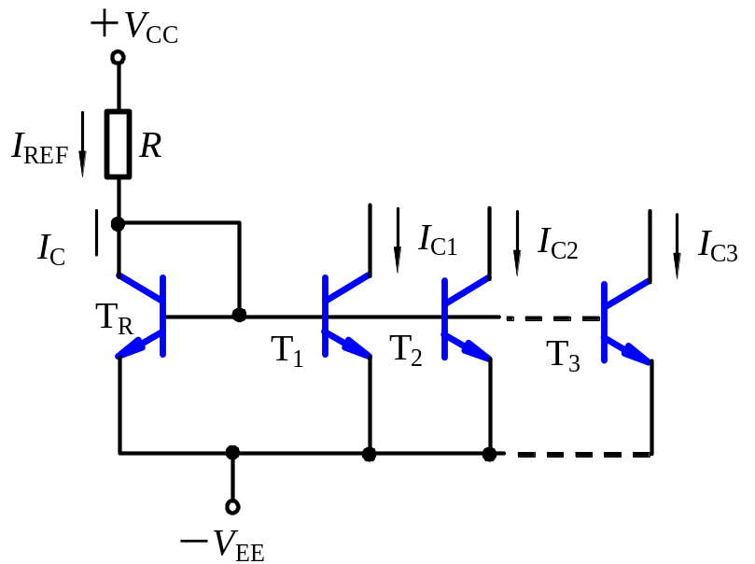
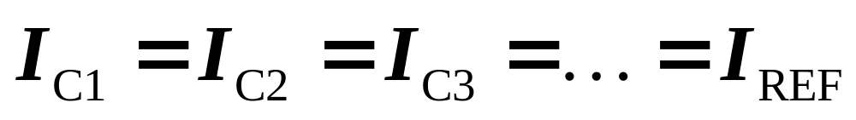
10.1.4 Multi-transistor Current Source
T and R serve as the reference for all output transistors.
T_{R} supplies the total base currents.
T_{R} makes I_{REF}≈ I_{C}.
There are N output transistors.

Slide 12
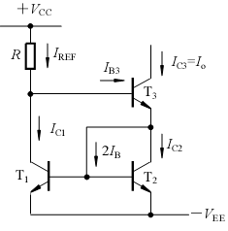

10.1 Bipolar Transistor Current Sources
I_{REF}=?

Slide 13
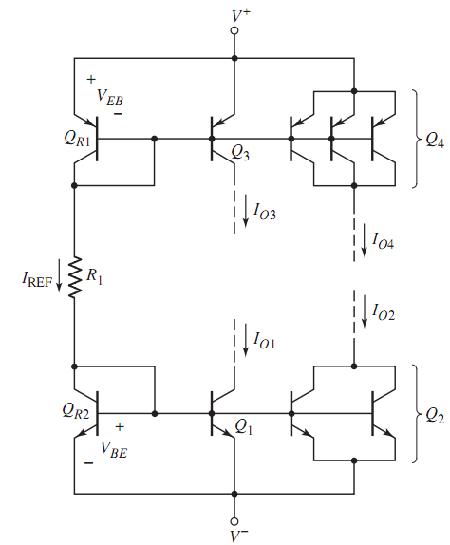
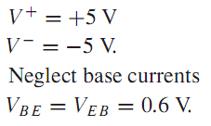





10.1.4 Multi-transistor Current Source

Slide 14
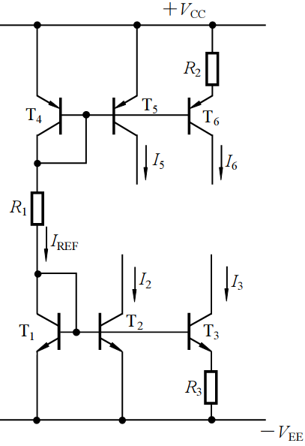
10.1 Bipolar Transistor Current Sources
reference current
Widlar current source
Widlar current source
Current Mirror

Slide 15
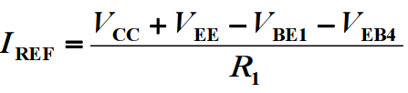
I_{REF}=?

Slide 16

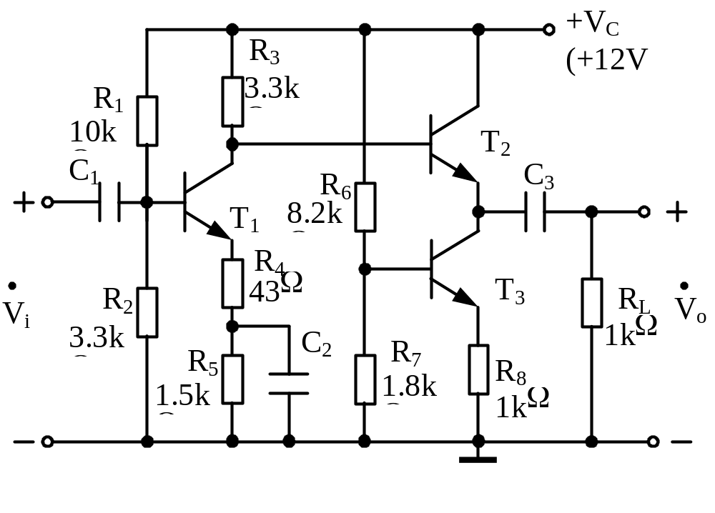
Example
CE
CC
c
b
e
b
current source

Slide 17
Contents
PART 1 SEMICONDUCTOR DEVICES AND BASIC APPLICATIONS
Chapter 1 Semiconductor Materials and Diodes
Chapter 2 Diode Circuits
Chapter 3 The Field-Effect Transistor
Chapter 4 Basic FET Amplifiers
Chapter 5 The Bipolar Junction Transistor
Chapter 6 Basic BJT Amplifiers
Chapter 7 Frequency Response
Chapter 8 Output Stages and Power Amplifiers
PART 2 ANALOG ELECTRONICS
Chapter 9 Ideal Operational Amplifiers and Op-Amp Circuits
Chapter 10 Integrated Circuit Biasing and Active Loads
Chapter 11 Differential and Multistage Amplifiers
Chapter 12 Feedback and Stability
Chapter 13 Operational Amplifier Circuits
Chapter 14 Nonideal Effects in Operational Amplifier Circuits
Chapter 15 Applications and Design of Integrated Circuits
Chapter 10 Integrated Circuit Biasing and Active Loads

Slide 18
10.1 Bipolar Transistor Current Source
10.2 FET Current Source
10.3 Circuit with Active Loads
10.4 Small-Signal Analysis: Active Load Circuits

Slide 19


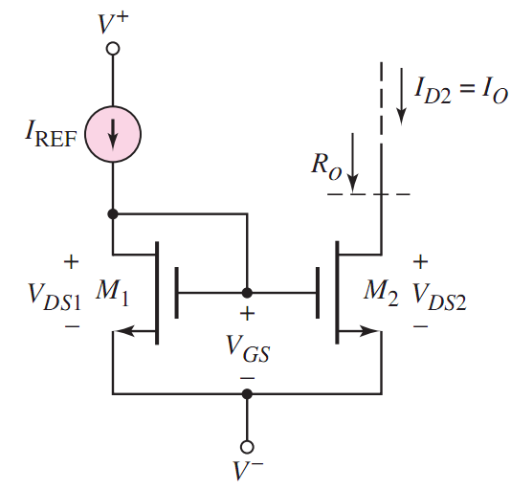


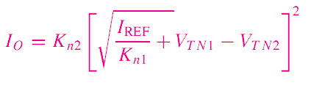


10.2 FET Current Sources
10.2.1 Basic Current Source

Slide 20


10.2 FET Current Sources
10.2.1 Basic Current Source

Slide 21
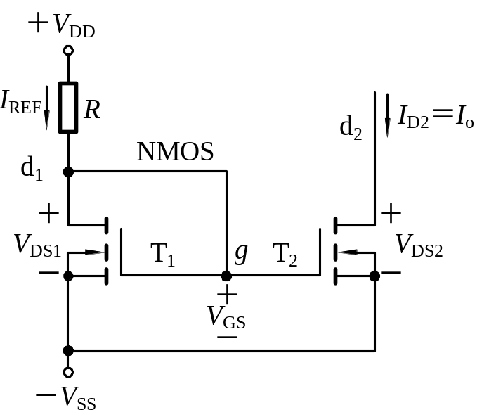
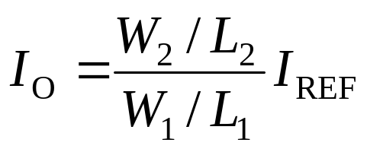
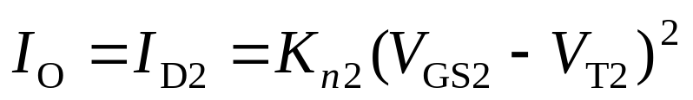
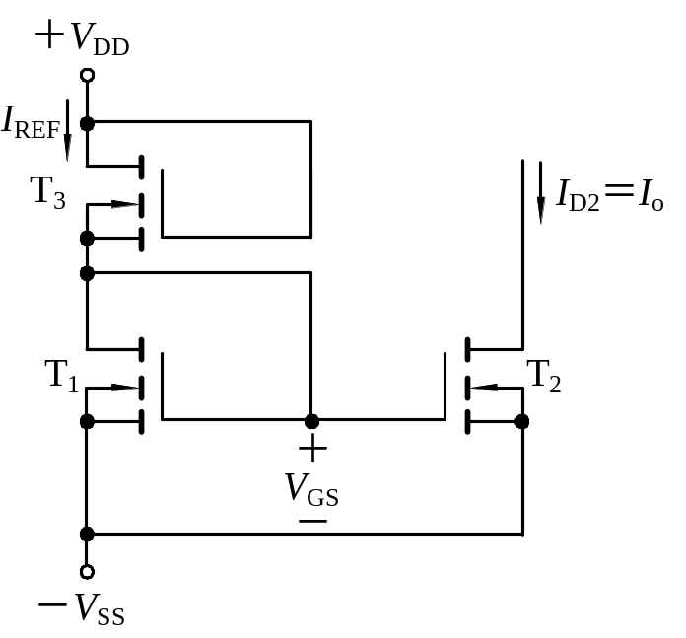
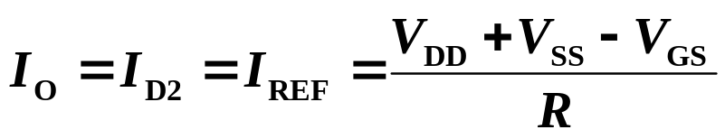
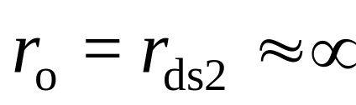
10.2 FET Current Sources
10.2.1 Basic Current Source
Load current
Output Resistance
T₃ substitute R

Slide 22
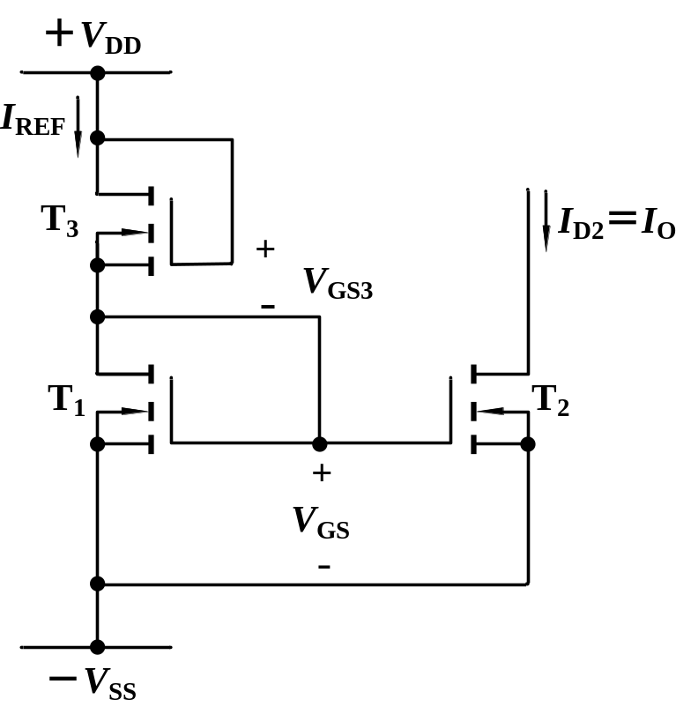
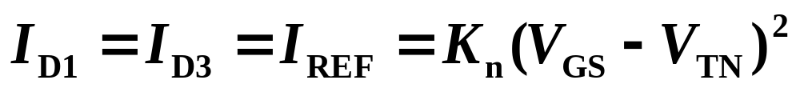
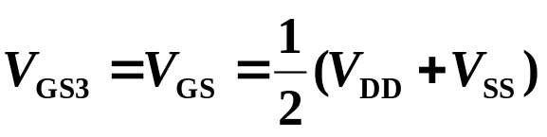

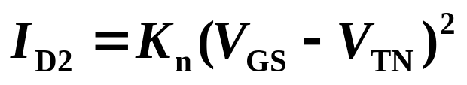
10.2 FET Current Sources

Slide 23
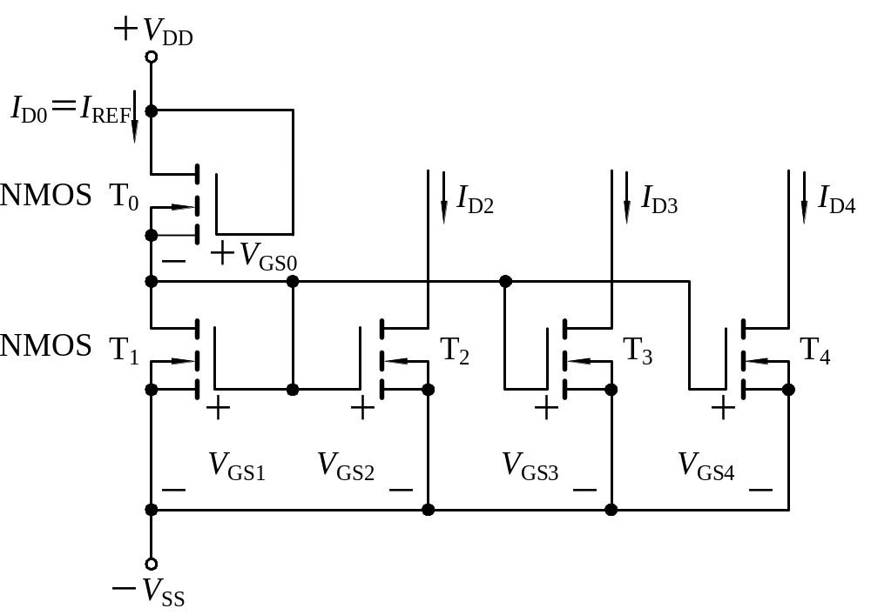
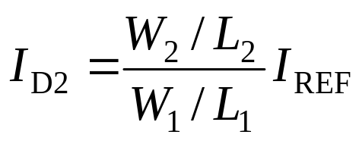
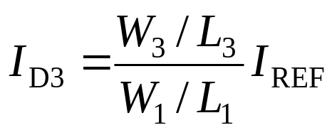
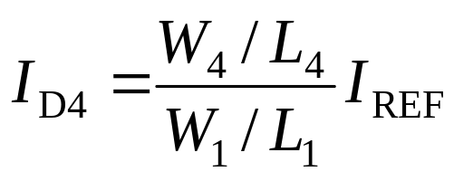
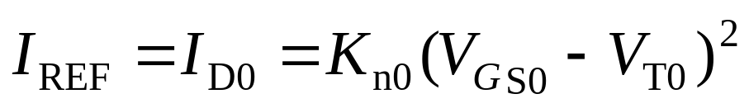
10.2 FET Current Sources
10.2.2 Multi-MOSFET Current Source
Currents

Slide 24
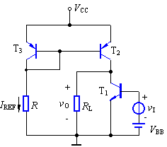
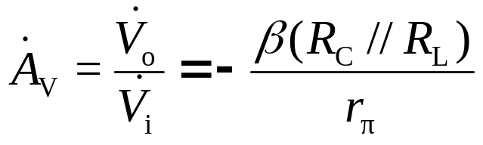
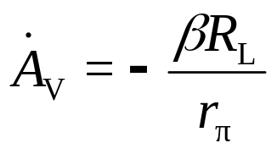
10.3 circuit with active loads
Current Source
T₂, T₃ , R form active load in amplifier T₁ circuit.
Voltage gain of CE：
Equivalent ac output resistance of current source is the load for T₁ , and very large.
Amplifier
common-emitter
Voltage gain with active load is greater than
that of no active load.

Slide 25
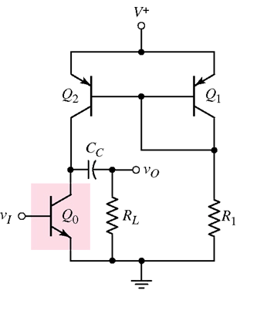


10.4 Small-Signal Analysis: Active Load Circuits
Active Load
small-signal equivalent circuit
r_{o2}=?
r_{o2}=r_{ce2}
Simple BJT amplifier with active load

Slide 26


current source
Integrated Circuit Biasing
Active Loads

Slide 27






Summary

